Slide 1
Python Tutorial
Lecture 1
Start to write a Python program
For SJSU MSDA Students
Jerry Lee
9/22/2018

Slide 2
Goal
To Learn
Basic knowledge about computer techniques
Write programs in Python from beginning
Read and analyze others program
How to study by yourself!

Slide 3
Reference Materials
Textbook:
Think Python 2 [Download]
Reference books:
Learn Python 3 the Hardware Way (Application) [Download]
Data Structures and Algorithms in Python [Download]
Online documentation
Slides and sample code download:
Github
QuickLink [https://goo.gl/bsh31Y]
Or go to github.com/MengHuanLee, find repository SJSU_MSDA_Python

Slide 4
What is a Program?
A program is a sequence of instructions that specifies how to perform a computation.
input: Get data from the keyboard, a file, the network, or some other device.
output: Display data on the screen, save it in a file, send it over the network, etc.
math: Perform basic mathematical operations like addition and multiplication.
conditional execution: Check for certain conditions and run the appropriate code.
repetition: Perform some action repeatedly, usually with some variation

Slide 5
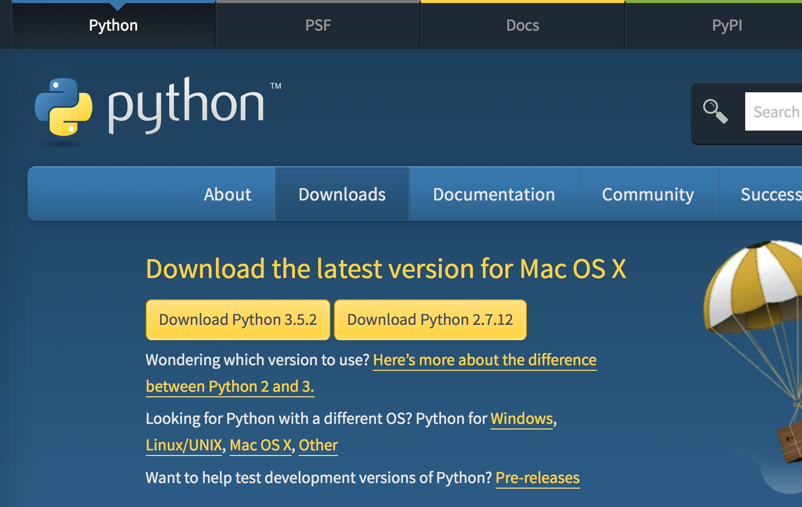
Python integrated development environment
An IDE (integrated development environment) is a set of tools necessary for developing applications using a specific programming language
Python has many IDE’s and we will use the standard Python development kit that includes IDLE:
http://python.org/download
On Windows, when you install, select the option:
Add Python to PATH

Slide 6
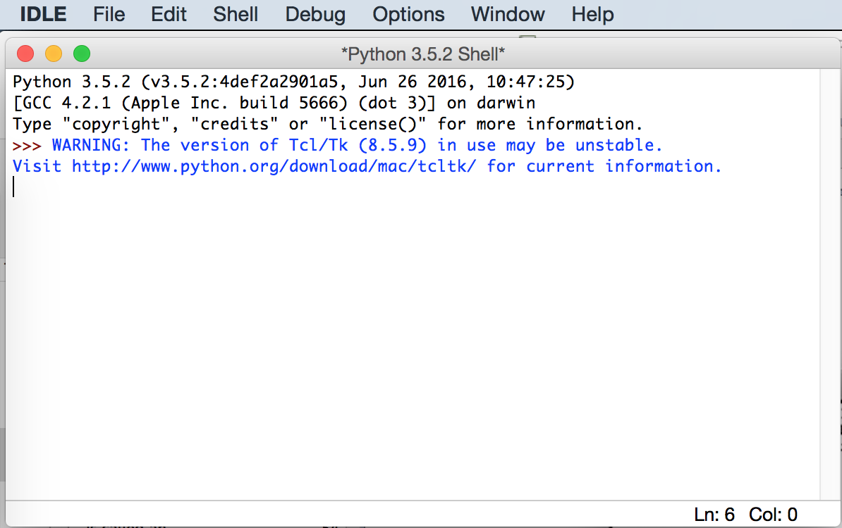
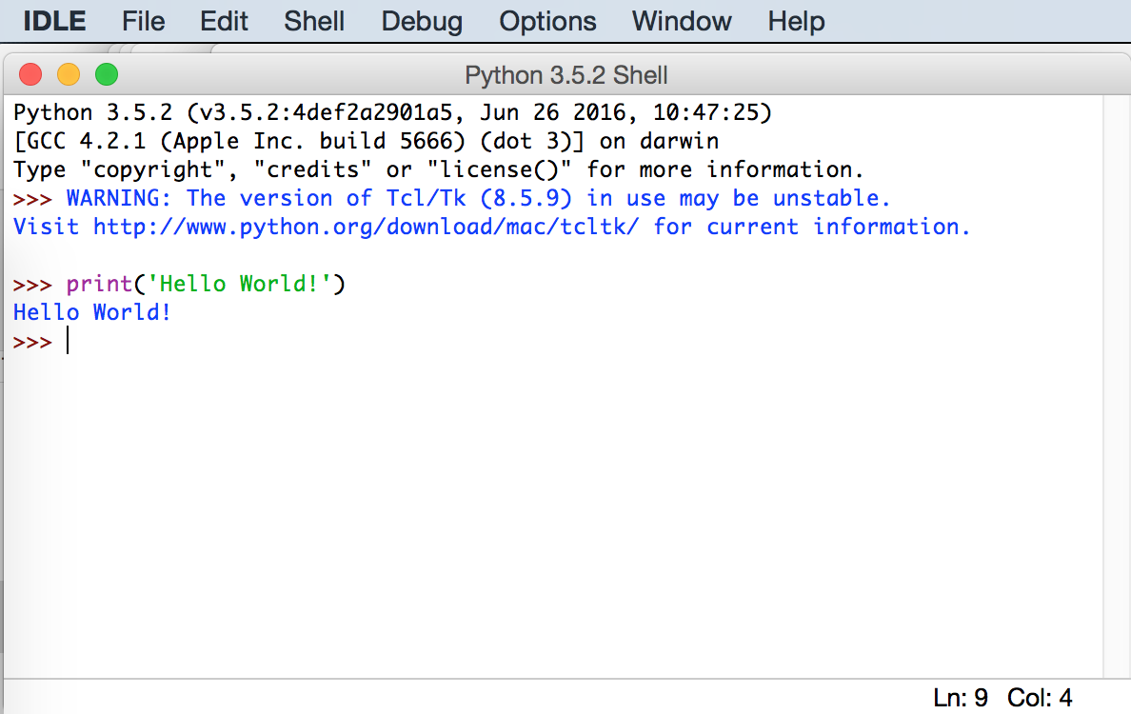
IDLE – Python shell
The following is IDLE Python interactive shell
User can enter python instructions to the Python shell
Type the following instruction:
print(‘Hello World!’)

Slide 7
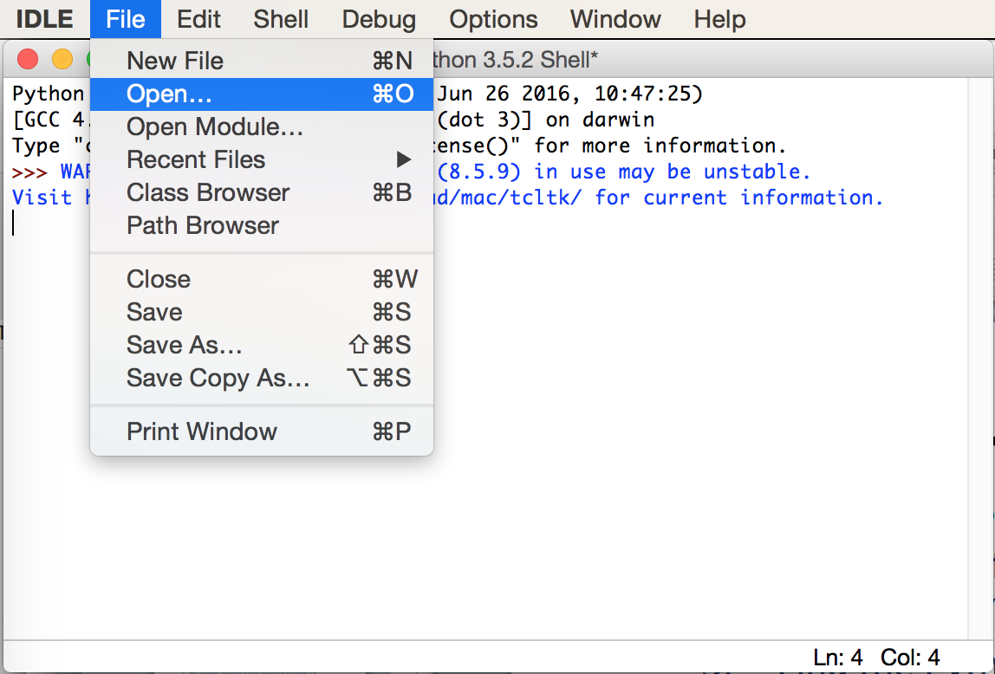
IDLE – Running saved Python programs (1/3)
You can run saved files that contain Python programs in IDLE:
Select “File” from the IDLE menu
Then select “Open” from the pull-down menu
Find the Python file that you would like to modify or execute and click “Open”
Alternatively, if you want to create a new Python program, select “New File”; Remember to save the file after you are done editing.

Slide 8
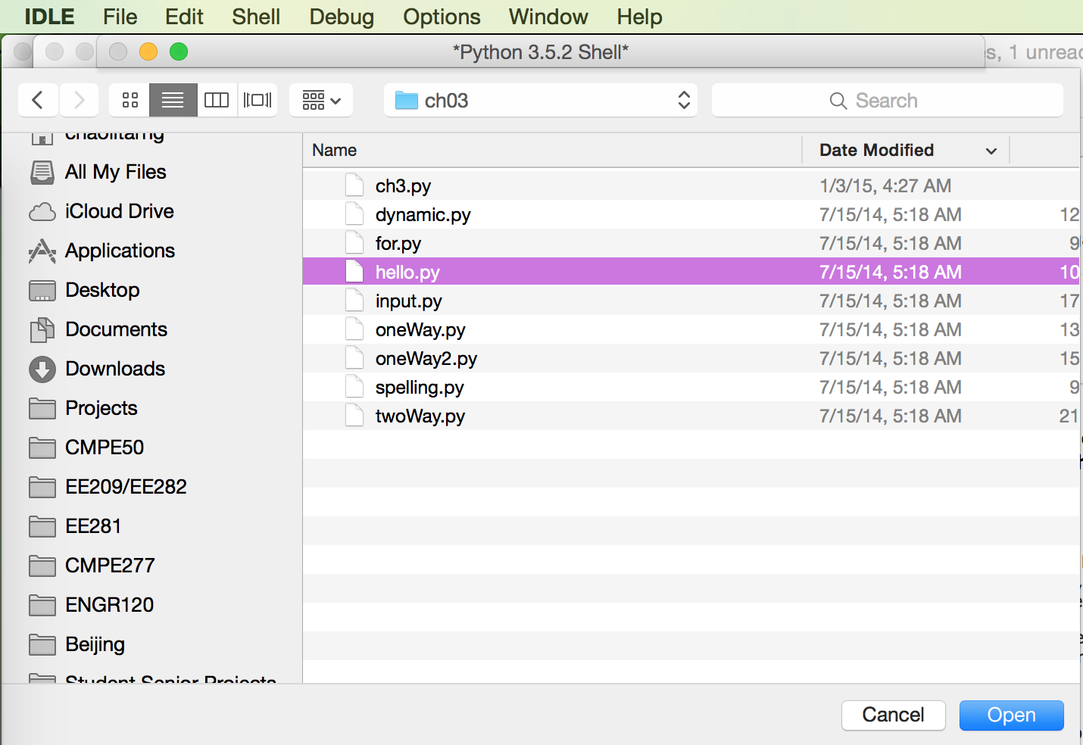
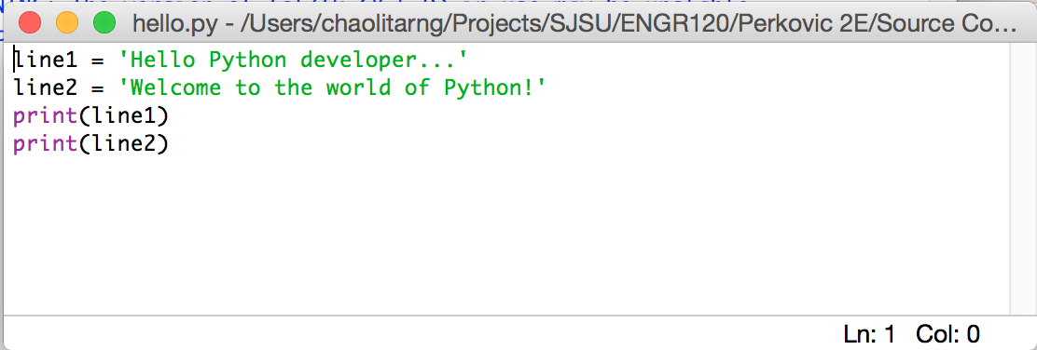
IDLE – Running saved Python programs (2/3)
For example, the file hello.py contains a few lines of Python code

Slide 9
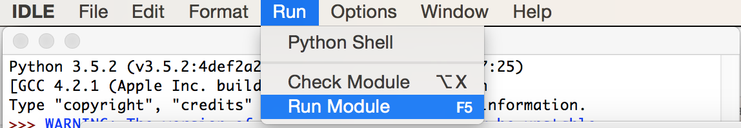
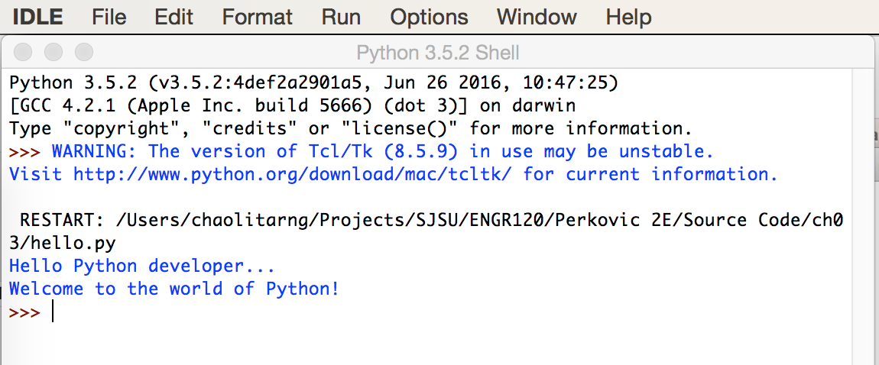
IDLE – Running saved Python programs (3/3)
The program in the file, e.g., hello.py, can be executed by selecting the “Run” option from the IDLE menu, then “Run Module F5” from the pull-down menu. The result is then shown in the IDLE Python shell window as show below.

Slide 10
Installing Python Packages
After installing IDLE, Python shell is available and it comes with the standard library, which has many of the useful modules and functions
Should you need to install additional Python libraries, called packages, you need to open a terminal:
On Mac, in Finder, go to Applications, then Utilities, click on Terminal
On Windows, click Start, enter “cmd” in the Run Command window
In the terminal, run the following command
pip3 install <package> # on Mac
pip install <package> # on Windows
For example, if you want to install numpy package
pip3 install numpy # on Mac
pip install numpy # on Windows

Slide 11
Installing PyCharm IDE
PyCharm [Download]
Coding area
File browser
Output and debug control

Slide 12
How to analyze a program?
Introduction to Computing Using Python
Break down programs into parts
1. import
2. functions and classes
3. main function
def func1(x):
Main function
Do something
Return value
Code
R1 = func1(x)
R2 = func2(y)
Return
def func2(y):
Do something
Return value

Slide 13
Program overview example

Slide 14
Variables and assignments
Introduction to Computing Using Python
Just as in algebra, a value can be assigned
to a variable, such as x
When variable x appears inside an expression, it evaluates to its assigned value
>>> x = 3 >>>
>>> x = 3 >>> x 3
>>> 4*x 16 >>>
>>> x = 3 >>> x 3
>>> 4*x 16 >>> y
Traceback (most recent call last):
File "<pyshell#59>", line 1, in <module>
y
NameError: name 'y' is not defined
>>> x = 3 >>> x 3
>>> 4*x 16 >>> y
Traceback (most recent call last):
File "<pyshell#59>", line 1, in <module>
y
NameError: name 'y' is not defined
>>> y = 4*x
>>>
>>> x = 3 >>> x 3
>>> 4*x 16 >>> y
Traceback (most recent call last):
File "<pyshell#59>", line 1, in <module>
y
NameError: name 'y' is not defined
>>> y = 4*x
>>> y
16.0
A variable (name) does not exist until it is assigned
The assignment statement has the format
<expression> is evaluated first, and the resulting value is assigned to variable <variable>
<variable> = <expression>

Slide 15
Naming rules
Introduction to Computing Using Python
(Variable) names can contain these characters:
a through z
A through Z
the underscore character _
digits 0 through 9
>>> My_x2 = 21
>>> My_x2
21
>>> My_x2 = 21
>>> My_x2
21
>>> 2x = 22
SyntaxError: invalid syntax
>>> new_temp = 23
>>> newTemp = 23
>>>
>>> My_x2 = 21
>>> My_x2
21
>>> 2x = 22
SyntaxError: invalid syntax
>>> new_temp = 23
>>> newTemp = 23
>>> counter = 0
>>> temp = 1
>>> price = 2
>>> age = 3
>>> My_x2 = 21
>>> My_x2
21
>>> 2x = 22
SyntaxError: invalid syntax
>>>
Names cannot start with a digit though
For a multiple-word name, use
either the underscore as the delimiter
or camelCase capitalization
Short and meaningful names are ideal

Slide 16
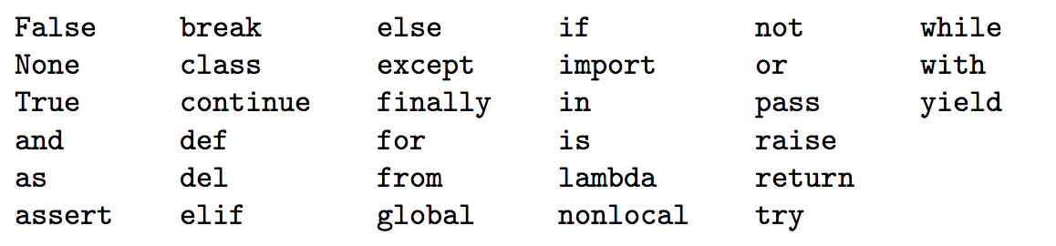
Python reserved keywords
Introduction to Computing Using Python
Variable names are case sensitive. For example, myList and MyList are different variable names.
The names below are reserved keywords of Python. You cannot use them other than Python instructions.

Slide 17
Simple program
Introduction to Computing Using Python
line1 = 'Hello Python developer...'
A Python program is a sequence of Python statements
Stored in a text file called a Python module
Executed using an IDE or “from the command line”
line2 = 'Welcome to the world of Python!'
print(line1)
print(line2)
line1 = 'Hello Python developer...'
line2 = 'Welcome to the world of Python!'
print(line1)
print(line2)
line1 = 'Hello Python developer...'
line2 = 'Welcome to the world of Python!'
print(line1)
print(line2)
line1 = 'Hello Python developer...'
line2 = 'Welcome to the world of Python!'
print(line1)
print(line2)
line1 = 'Hello Python developer...'
line2 = 'Welcome to the world of Python!'
print(line1)
print(line2)
line1 = 'Hello Python developer...'
line2 = 'Welcome to the world of Python!'
print(line1)
print(line2)
$ python hello.py
$ python hello.py
Hello Python developer…
Welcome to the world of Python!
$ python hello.py
Hello Python developer…
hello.py

Slide 18
What is a function
A function is a named sequence of statements that performs a computation
Body of the function should be indented consistently (4 spaces is typical in Python)‏
def square(n): return n*n print ("The square of 3 is ",) print (square(3)) Output: The square of 3 is 9

Slide 19
Functions
Define functions use “def: “
Body of the function should be indented consistently (4 spaces is typical in Python)‏
def square(n): return n*n print ("The square of 3 is ",) print (square(3)) Output: The square of 3 is 9

Slide 20
Built-in function print()
Introduction to Computing Using Python
Function print() prints its input argument to the IDLE window
The argument can be any object: an integer, a float, a string, a list, …
Strings are printed without quotes and “to be read by people”, rather than “to be interpreted by Python”,
The “string representation” of the object is printed
>>> print(0)
0
>>> print(0.0)
0.0
>>> print('zero')
zero
>>> print([0, 1, 'two'])
[0, 1, 'two']

Slide 21
Built-in function input()
Introduction to Computing Using Python
Function input() requests and reads input from the user interactively
It’s (optional) input argument is the request message
Typically used on the right side of an assignment statement
When executed:
When executed:
The input request message is printed
When executed:
The input request message is printed
The user enters the input
The string typed by the user is assigned to the variable on the left side of the assignment statement
When executed:
The input request message is printed
The user enters the input
>>> name = input('Enter your name: ')
Enter your name: Michael
>>> name
'Michael'
>>> ========= RESTART =============
>>>
Enter your first name: Michael
Enter your last name: Jordan
Hello Michael Jordan...
Welcome to the world of Python!
>>> name = input('Enter your name: ')
>>> name = input('Enter your name: ')
Enter your name: Michael
>>> name
'Michael'
>>> ========= RESTART =============
>>>
Enter your first name: Michael
Enter your last name:
>>> name = input('Enter your name: ')
Enter your name:
>>> name = input('Enter your name: ')
Enter your name: Michael
>>> name = input('Enter your name: ')
Enter your name: Michael
>>> name
'Michael'
>>> name = input('Enter your name: ')
Enter your name: Michael
>>> name
'Michael'
>>> ========= RESTART =============
>>>
Enter your first name:
>>> name = input('Enter your name: ')
Enter your name: Michael
>>>
first = input('Enter your first name: ')
last = input('Enter your last name: ')
line1 = 'Hello’ + first + '' + last + '…'
print(line1)
print('Welcome to the world of Python!')
first = input('Enter your first name: ')
last = input('Enter your last name: ')
line1 = 'Hello’ + first + '' + last + '…'
print(line1)
print('Welcome to the world of Python!')
first = input('Enter your first name: ')
last = input('Enter your last name: ')
line1 = 'Hello’ + first + '' + last + '…'
print(line1)
print('Welcome to the world of Python!')
first = input('Enter your first name: ')
last = input('Enter your last name: ')
line1 = 'Hello’ + first + '' + last + '…'
print(line1)
print('Welcome to the world of Python!')
input.py

Slide 22
Exercise
Introduction to Computing Using Python
Write a program that:
Requests the user’s name
Requests the user’s age
Prints a message saying whether the user is eligible to vote or not
Need a way to execute a Python statement
if a condition is true

Slide 23
Algebraic expressions
Introduction to Computing Using Python
The Python interactive shell can be used
to evaluate algebraic expressions, just like a calculator
>>> 2 + 3
5
>>> 7 - 5
2
>>> 2*(3+1)
8
>>> 5/2
2.5
>>> 5//2
2
>>> 14//3
4
>>> 14%3
2
>>> 2 + 3
5
>>> 7 - 5
2
>>> 2*(3+1)
8
>>> 5/2
2.5
>>> 5//2
2
>>> 14//3
4
>>> 14%3
2
>>> 2**3
8
>>> abs(-3.2)
3.2
>>> 2 + 3
5
>>> 7 - 5
2
>>> 2*(3+1)
8
>>> 5/2
2.5
>>> 5//2
2
>>> 14//3
4
>>> 14%3
2
>>> 2**3
8
>>> abs(-3.2)
3.2
>>> min(23,41,15,24)
15
>>> 2 + 3
5
>>> 7 - 5
2
>>> 2*(3+1)
8
>>> 5/2
2.5
>>> 5//2
2
>>> 14//3
4
>>> 14%3
2
>>> 2**3
8
>>> abs(-3.2)
3.2
>>> min(23,41,15,24)
15
>>> max(23,41,15,24)
41
>>> 2 + 3
5
>>> 7 - 5
2
>>> 2*(3+1)
8
>>> 5/2
2.5
>>> 2 + 3
5
>>> 7 - 5
2
>>> 2*(3+1)
8
>>> 5/2
2.5
>>> 5//2
2
>>> 14//3
4
>>> 14%3
2
>>> 2**3
8
>>> 2 + 3
5
>>> 7 - 5
2
>>> 2*(3+1)
8
>>> 2 + 3
5
>>> 2 + 3
5
>>> 7 - 5
2
>>> 2 + 3
5
>>> 7 - 5
2
>>> 2*(3+1)
8
>>> 5/2
2.5
>>> 5//2
2
14//3 is the quotient when 14 is divided by 3 and 14%3 is the remainder
2**3 is 2 to the 3rd power
abs(), min(), and max() are functions
abs() takes a number as input and returns its absolute value
min() (resp., max()) take an arbitrary number of inputs and return the “smallest” (resp., “largest”) among them

Slide 24
Python functions
Introduction to Computing Using Python
Python supports mathematical functions of the kind we have used in an algebra class. Recall that the notation
f(x) = x + 1
is used to define function f() that takes an input x, and return a value, which is x+1 in this case. For example, f(3) evaluates to 4.
Python functions are similar. As shown in the previous slide, abs(), min(), and max() are functions.
>>> abs(-4) 4
>>> abs(4)
4
>>> abs(-3.2)
3.2
>>> min(6, -2)
-2
>>> max(6, -2)
6
>>> min(2, -4, 6, -2)
-4
>>> max(12, 26.5, 3.5)
26.5

Slide 25
Type conversion
Introduction to Computing Using Python
bool
int
float
Implicit type conversion
When evaluating an expression that contains operands of different type, operands must first be converted to the same type
Operands are converted to the type that “contains the others”
Explicit type conversion
Constructors can be used to explicitly convert types
>>> 2 + 3.0
5.0
>>> True + 0
1
>>> int(2.1)
2
>>> int('456')
456
>>> int('45.6')
Traceback (most recent call last):
File "<pyshell#59>", line 1, in <module>
int('45.6')
ValueError: invalid literal for int() with base 10: '45.6’
>>> float('45.6')
45.6
>>> float(2**24)
16777216.0
>>> float(2**1024)
Traceback (most recent call last):
File "<pyshell#57>", line 1, in <module>
float(2**1024)
OverflowError: long int too large to convert to float
>>> str(345)
'345'
>>> str(34.5)
'34.5'
>>>
int() creates an int object
from a float object, by removing decimal part
from a str object, if it represents an integer
float() creates a float object
from an int object, if it is not too big
from a string, if it represents a number
str() creates a str object
the string representation of the object value

Slide 26
Python Standard Library
Introduction to Computing Using Python
The core Python programming language comes with functions such as
max() and sum() and classes such as int, str, and list.
Many more functions and classes are defined in the Python Standard Library to support
Network programming
Web application programming
Graphical user interface (GUI) development
Database programming
Mathematical functions
Pseudorandom number generators
Media processing, etc.
The Python Standard Library functions and classes are organized into components called modules.

Slide 27
Standard Library module math
Introduction to Computing Using Python
The core Python language does not have a square root function
The square root function sqrt() is defined in the Standard Library module math
>>> import math
>>> math.sqrt(4)
2.0
>>> sqrt(4)
Traceback (most recent call last):
File "<pyshell#10>", line 1, in <module>
sqrt(4)
NameError: name 'sqrt' is not defined
>>> help(math)
Help on module math:
…
>>> math.cos(0)
1.0
>>> math.log(8)
2.0794415416798357
>>> math.log(8, 2)
3.0
>>> math.pi
3.141592653589793
>>> import math
>>>
>>> import math
>>> math.sqrt(4)
2.0
>>> sqrt(4)
Traceback (most recent call last):
File "<pyshell#10>", line 1, in <module>
sqrt(4)
NameError: name 'sqrt' is not defined
>>>
A module must be explicitly imported into the execution environment:
import <module>
The prefix math. must be present when
using function sqrt()
The math module is a library of mathematical functions and constants

Slide 28
Math functions
Introduction to Computing Using Python
Math documentation [here]
>>> math.pi
>>> math.e
>>> math.log10(1000)
>>> math.log2 (8)
>>> math.sin (radians)
>>> math.cos (radians)

Slide 29
Exercise
Introduction to Computing Using Python
Write a Python expression that assigns to variable c
The length of the hypotenuse in a right triangle whose other two sides have lengths 3 and 4
The value of the Boolean expression that evaluates whether the length of the above hypotenuse is 5
The area of a disk of radius 10
The value of the Boolean expression that checks whether a point with coordinates (5, 5) is inside a circle with center (0,0) and radius 7.
>>> c = math.sqrt(3**2+4**2)
>>> c
5.0
>>> c = (math.sqrt(3**2+4**2) == 5)
>>> c
True
>>> c = math.pi*10**2
>>> c
314.1592653589793
>>> c = (2*5**2 < 7**2)
>>> c
False

Slide 30
Write a calculator program
Think before type
What are the requirement? Functions to implement?
Steps? Procedure? Sketch diagram
Write program
Test and debug

